Slide 1


DAYANANDA SAGAR UNIVERSITY
SCHOOL OF ENGINEERING
Computer Science and Engineering (AIML)
Minor Project Phase-I
AN AI DRIVEN TOOTH DEVELOPMENT STAGE FOR THE ESTIMATION OF DA:DEEP LEARNING APPROACHES
Under the Supervision
Prof. Subhash Mondal
Assistant Professor
Presented By:
G LAVANYA (ENG22AM0150)
HARSHITHA K (ENG22AM0152)
BHOMITHA KALLOLA (ENG22AM0171)
CHANDANA S HIREMATH (ENG22AM0172)

Slide 2
Content
Introduction
Literature Review
Problem Statement
Aim & Objectives
Detailed Architecture
References

Slide 3
Introduction
Dental age estimation plays a crucial role in various domains, including pediatric dentistry, orthodontics, and forensic science.
Traditional methods for dental age estimation often rely on manual assessments of tooth development stages, which can be subjective and time-consuming.
In recent years, advancements in deep learning, particularly convolutional neural networks (CNNs), have opened new avenues for automating and enhancing the efficiency of dental age prediction.
This project aims to find the root length of specific pre-molar and predict dental age using radiographic images.
By automating the analysis of dental images, we seek to improve the reliability and efficiency of age estimates.

Slide 4
Problem Statement
PROBLEMS:
Traditional methods such as Demirjian’s stages or population - specific conversion tables, which often suffer from inaccuracies due to variations across populations.
Manual interpretation errors, and limited adaptability.
These methods fail to generalize well across diverse demographic groups and can be cumbersome to use.
SOLUTION:
Solving the problem using deep learning models which can give accurate results compared to the traditional methods.

Slide 5
Aim & Objective
Aim:
The aim of predicting dental age using a deep learning model based on root length measurements is to provide an accurate, automated, and efficient method for estimating a dental age.
Objective:
To develop a deep learning-based system that accurately predicts the dental age of individuals by analyzing the root length of teeth in radiographic images. This system aims to:
Assist in forensic investigations by providing reliable age estimations.
Improve the precision of age determination in pediatric and orthodontic dentistry.
Automate and enhance the efficiency of traditional methods of dental age assessment.
Reduce subjectivity and potential errors associated with manual evaluation of root development.

Slide 6
Literature Review
Paper Title | Journal Name and year | Technology/design | Metrics | Advantages | Limitation
Age-Net: An Advanced Hybrid Deep Learning Model for Age Estimation Using Orthopantomograph Images | IIETA on Year -2023 | -In the study, seven feature extraction models different classification algorithms were used. | accuracy, precision, recall, fscore | The model gave high level of classification accuracy. The highest accuracy, sensitivity, achieved by the hybridization of EfficientNetB0 | The data used in the study are limited to certain age groups..The success rate would be high if we increase the number of age group
Dental Age Estimation Using Deep Learning: A Comparative Survey | mdpi on Jan 2023 | It is a comparative survey between different types of dental age determination techniques and different deep learning models | performance,methods used, accuracy and age group | As it is comparative study,we can find the best, suitable, efficient and low cost model for age determination | Dental Complications in Cleft Lip/Palate (CLP) Patients can make the dental age detection process difficult

Slide 7
Deep learning for automated age prediction using panoramic dental X-ray images | Journal of Forensic Sciences | It utilized transfer learning with ImageNet weights and was trained on a dataset of 21,007 images | accuracy, precision, recall | DentAge showed robust performance across diverse age groups and dental conditions, achieving an overall MAE of 3.12 years | The model exhibited increased mean absolute error (MAE) for older age groups, with the highest MAE of 13.40 years for individuals aged 90–100
Fully automated deep learning approach to dental development assessment | BMC oral health in 2024 | Uses algorithms like YOLOv5,U-net, efficientnet | accuracy, performance,cost | Serves as a supportive tool for dentists, facilitating rapid and objective dental age estimation and dental maturity | traditional methods like demirijian are less accurate compared to machine learning techniques
Comparison of different machine learning approaches to predict dental age using Demirjian’s staging approach | Springer link and 2021 | 10 ML algorithms (e.g., Random Forest, SVM) applied to Demirjian’s dental staging using 3,605 orthopantomograms | MAE, MSE, RMSE, for accuracy and bias .Best MAE: 0.731 years (Random Forest) worst: 1.108 years (Demirjian’s). | Higher accuracy than traditional methods. No need for population-specific tables.Adaptable for different age ranges. | Some models are black boxes.Increased variability for ages 16-24.Large datasets required.

Slide 8
Sustainable Development Goals
The Sustainable Development Goal (SDG) of Good Health and Well-being (SDG 3) focuses on ensuring healthy lives for all. Our project on dental age prediction supports this goal by enhancing healthcare diagnostics. Accurate dental age estimation aids in identifying growth delays, ensuring timely medical interventions, and contributing to child health improvement, aligning with SDG Target 3.2 to reduce preventable deaths.
It also supports forensic identification and ethical decision-making in legal contexts. By offering a non-invasive and accessible diagnostic tool, our project promotes equitable health care, advancing innovation and ensuring better health outcomes, particularly for underserved populations, in line with SDG 3.

Slide 9
Methodology:
1. Preprocessing:-
Objective: Noise Reduction, Image Normalization.
2. Object Detection (Region of Interest):-
Objective: To detect the region containing the specific pre-molar teeth using YOLOv8.
3. Edge Detection:-
Objective: To detect the edge of the teeth using Canny Edge Detection.
4. Root Length Calculation:-
Objective: To measure the root length of the premolar teeth using Canny Edge Detection.
5.Prediction model:-
Objective: To estimate the dental age based on root length of the teeth using ResNet-50.

Slide 10
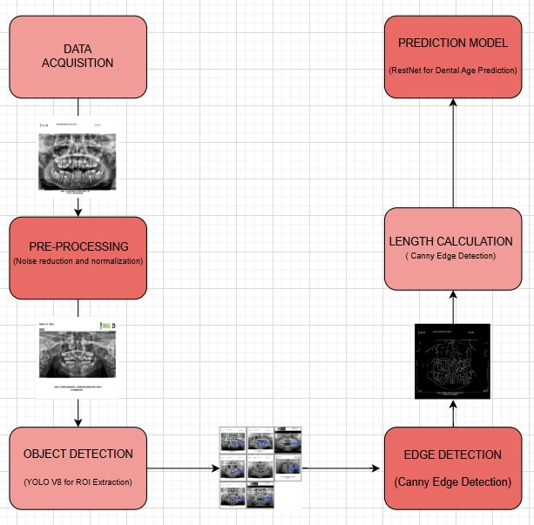
Model Architecture

Slide 11
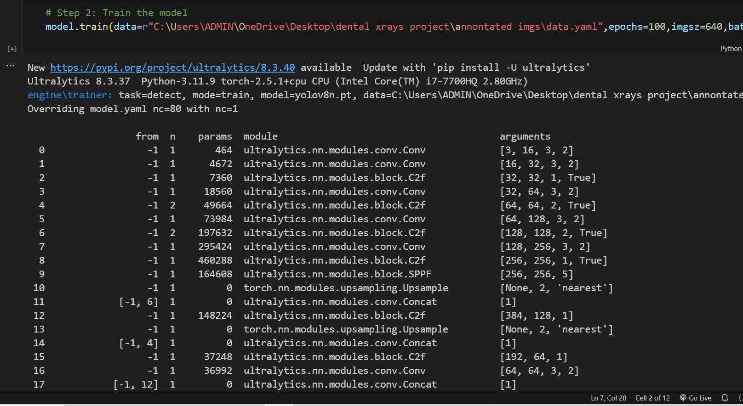
Code

Slide 12
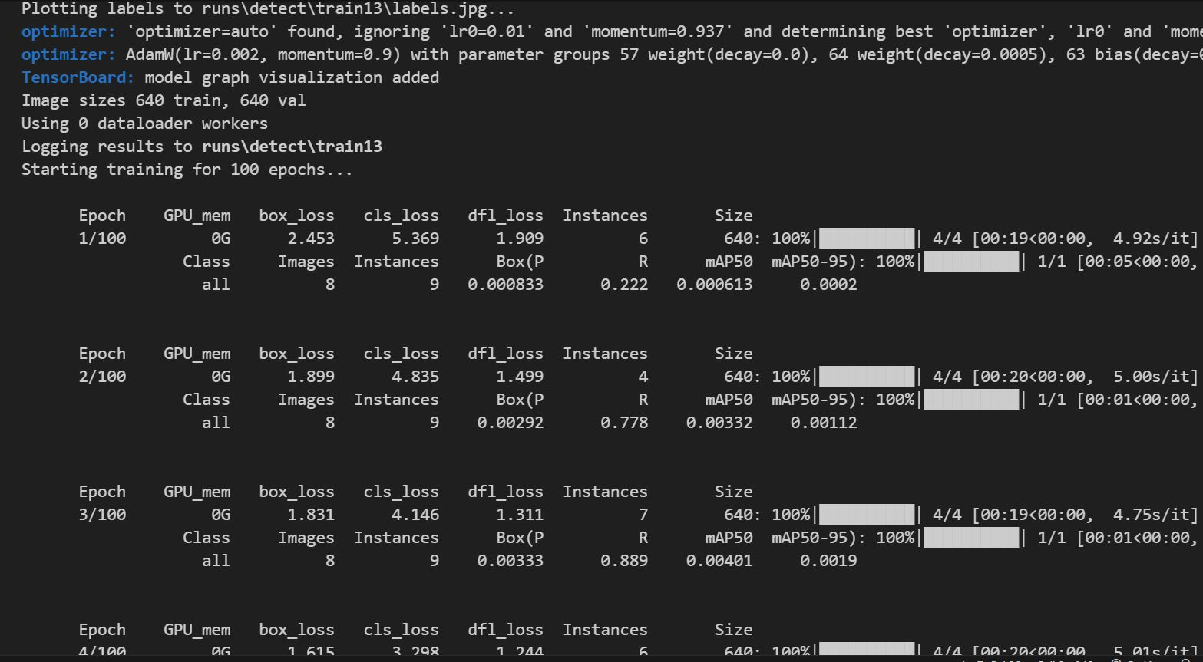
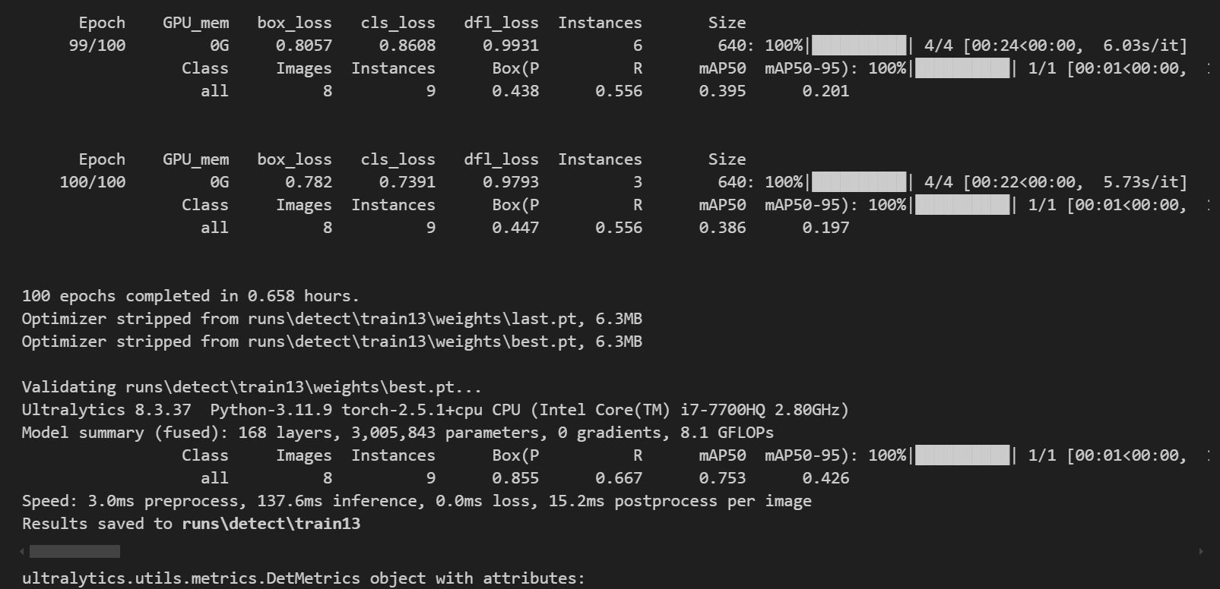

Slide 13
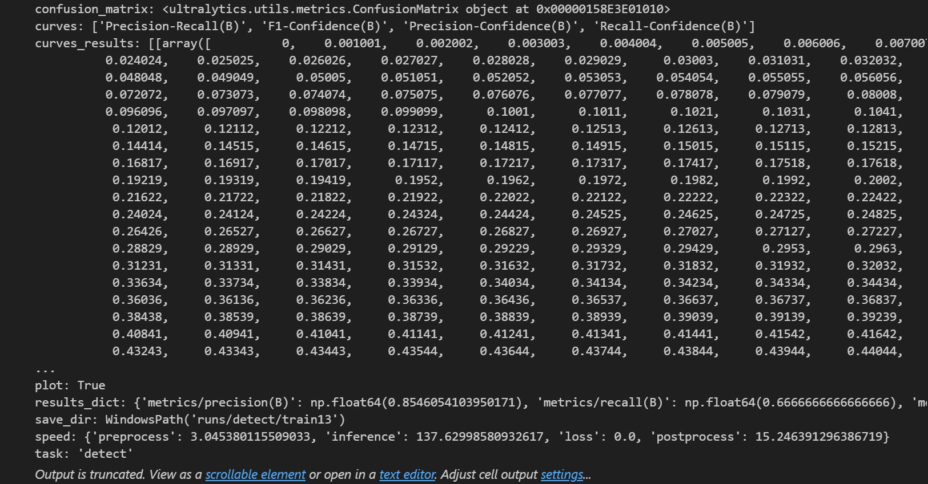
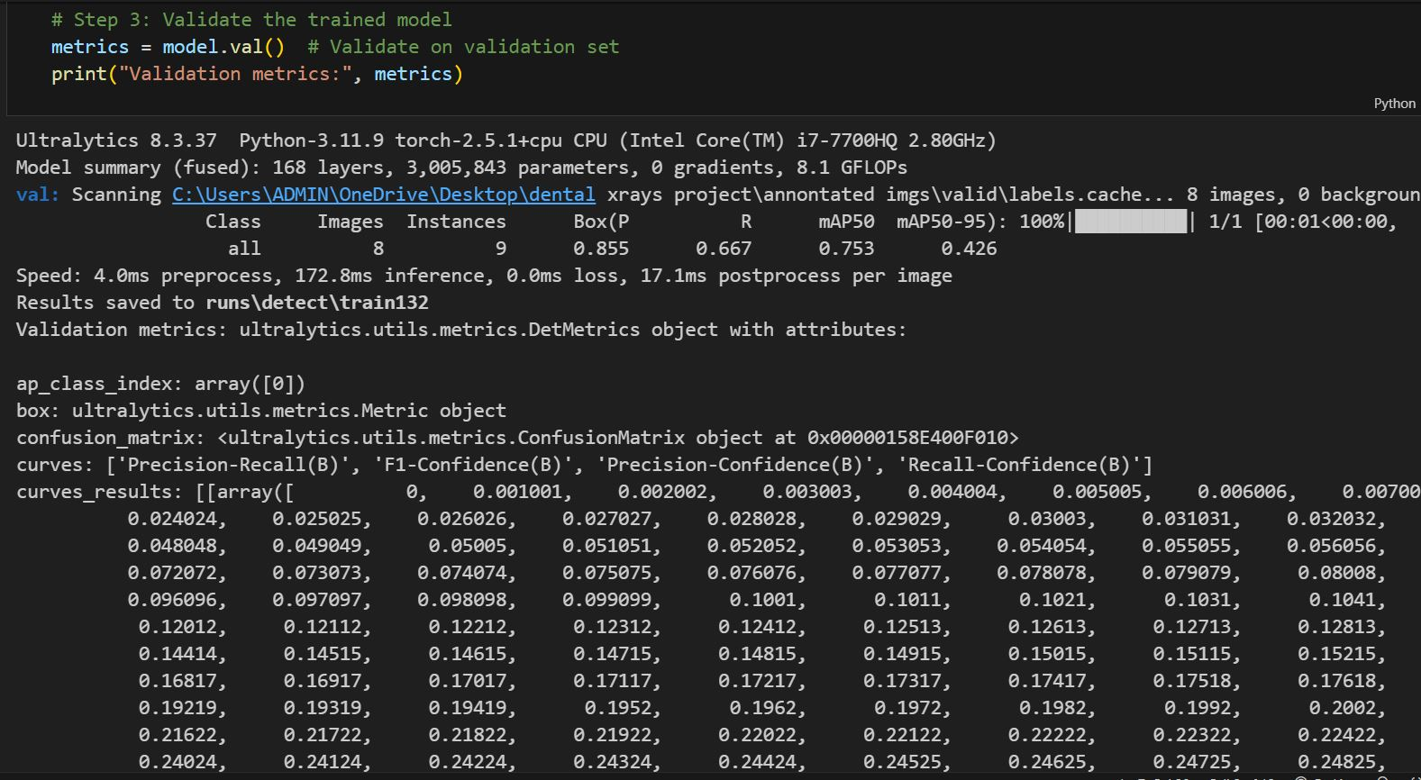

Slide 14
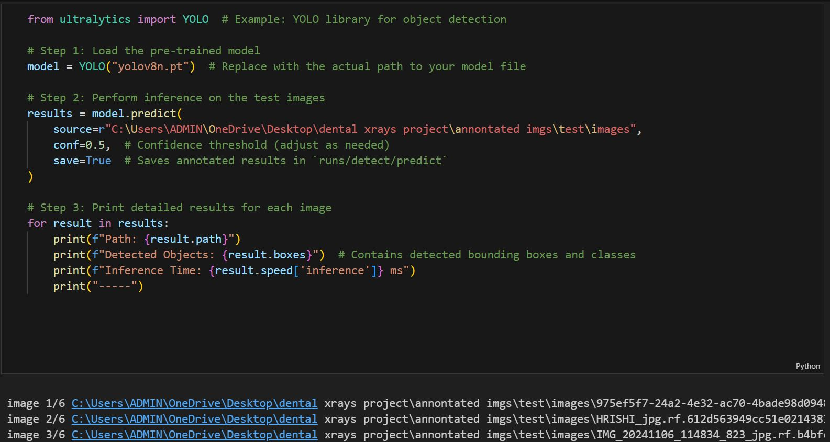
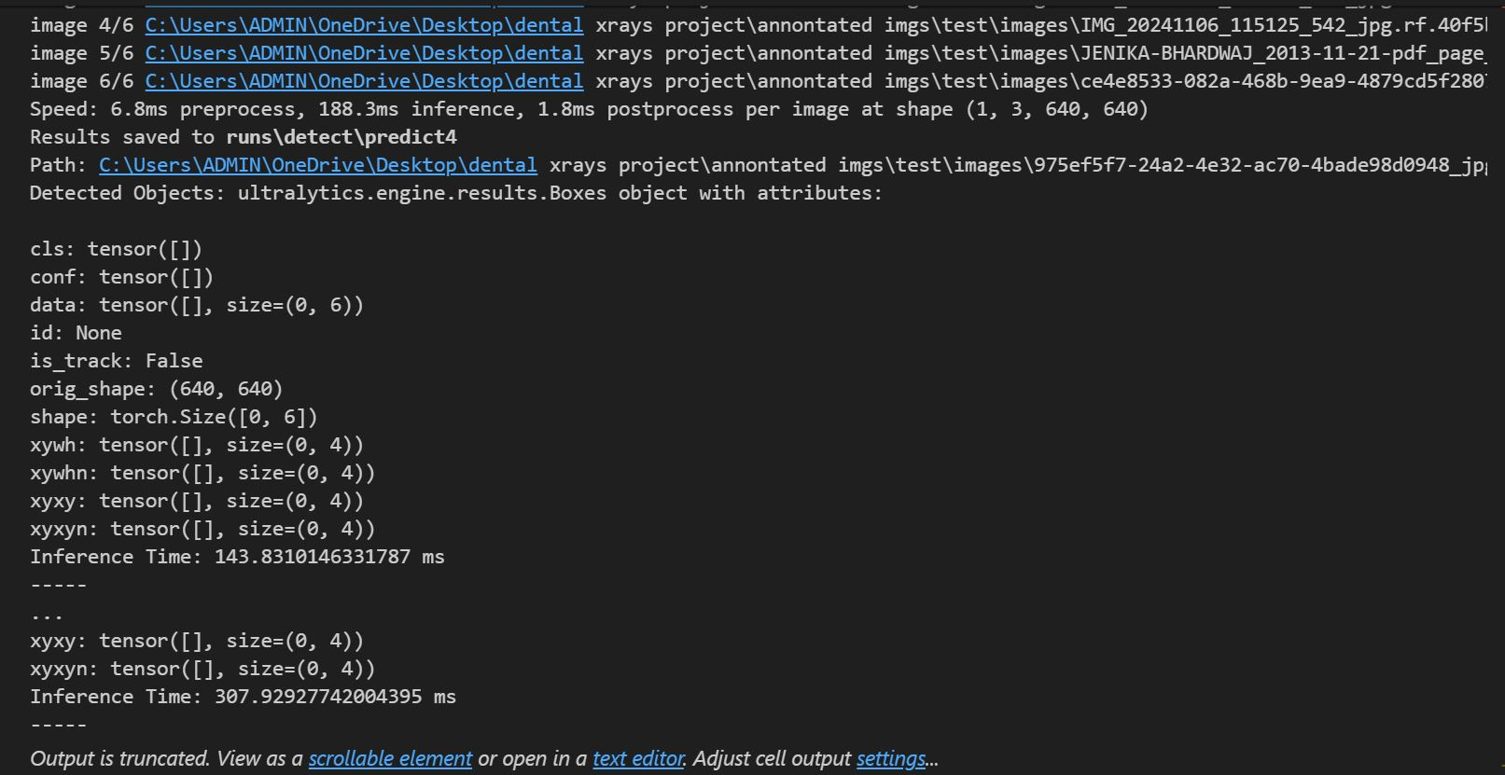

Slide 15
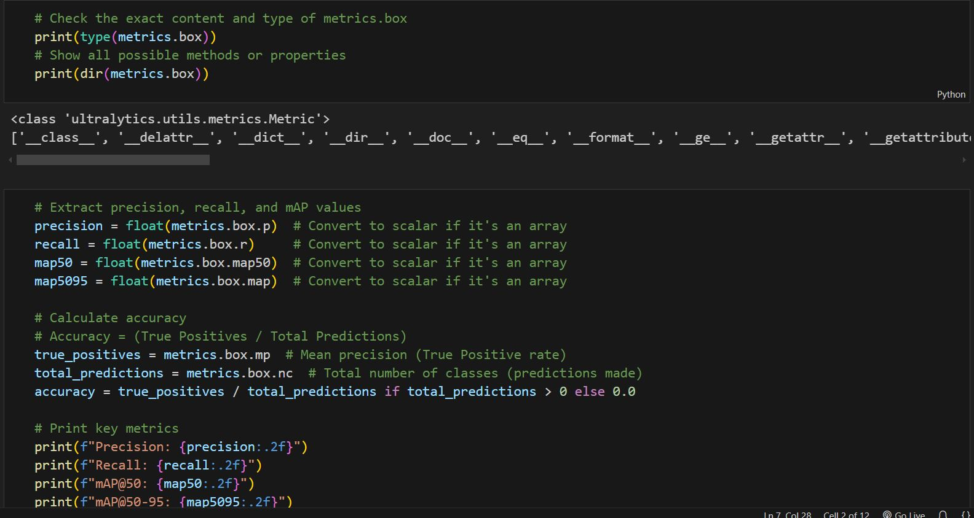
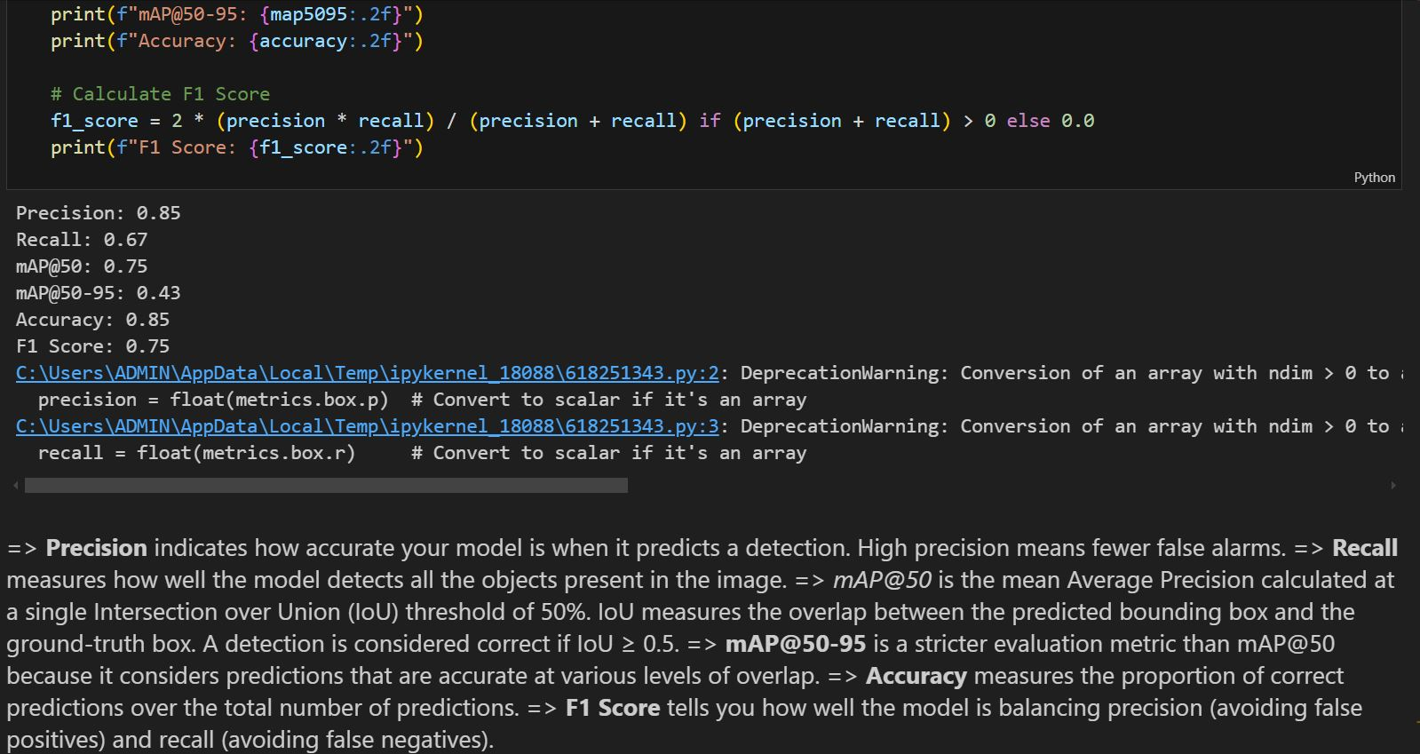

Slide 16
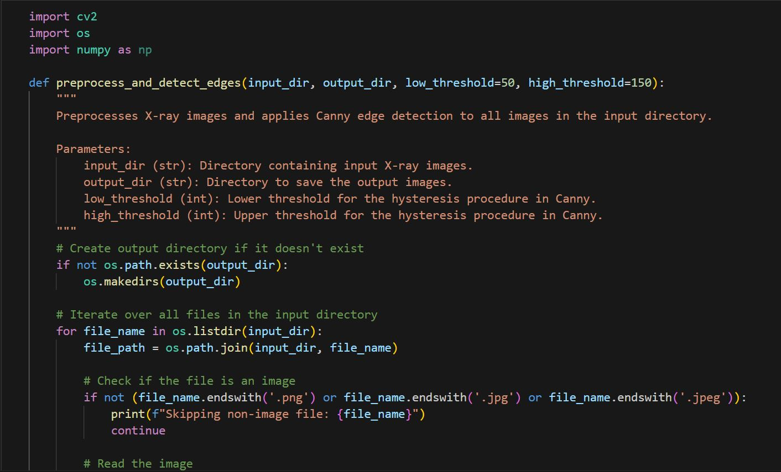
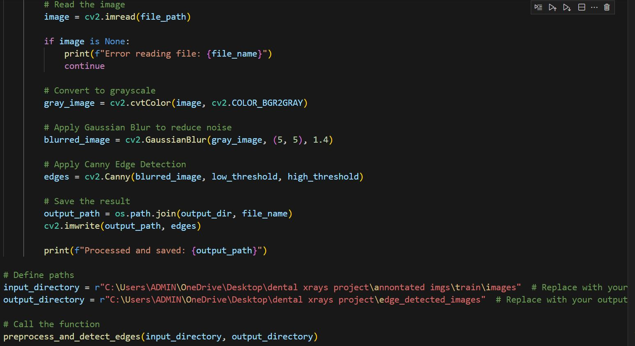

Slide 17
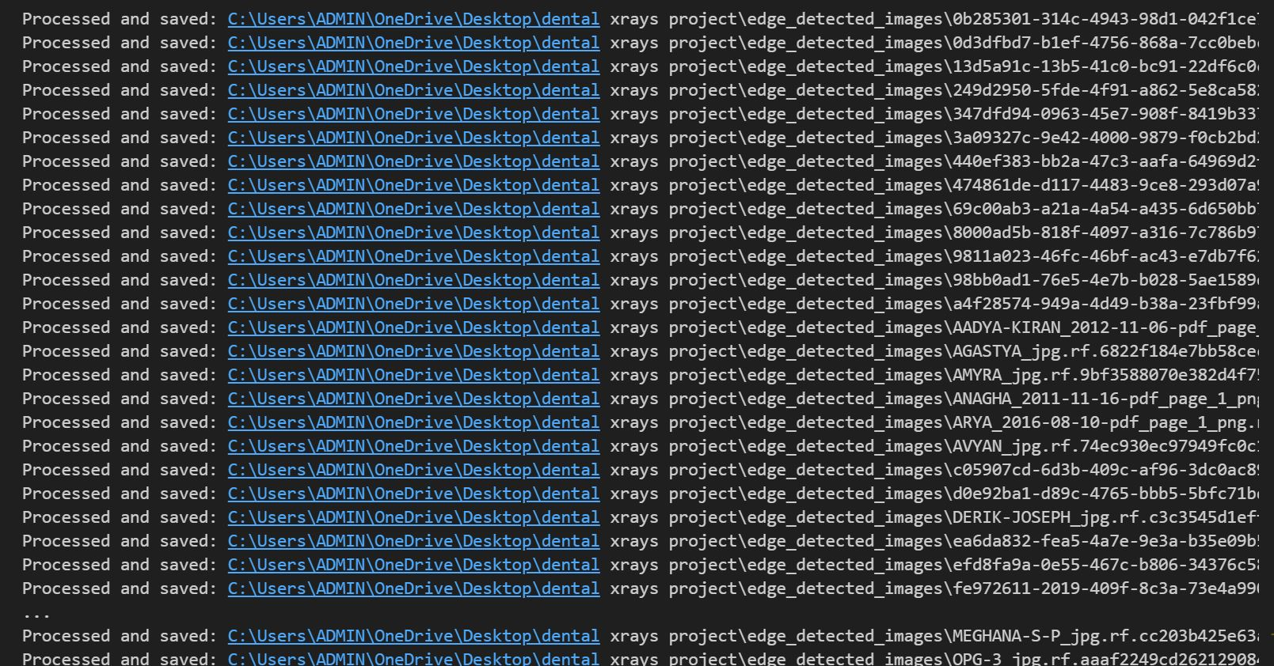
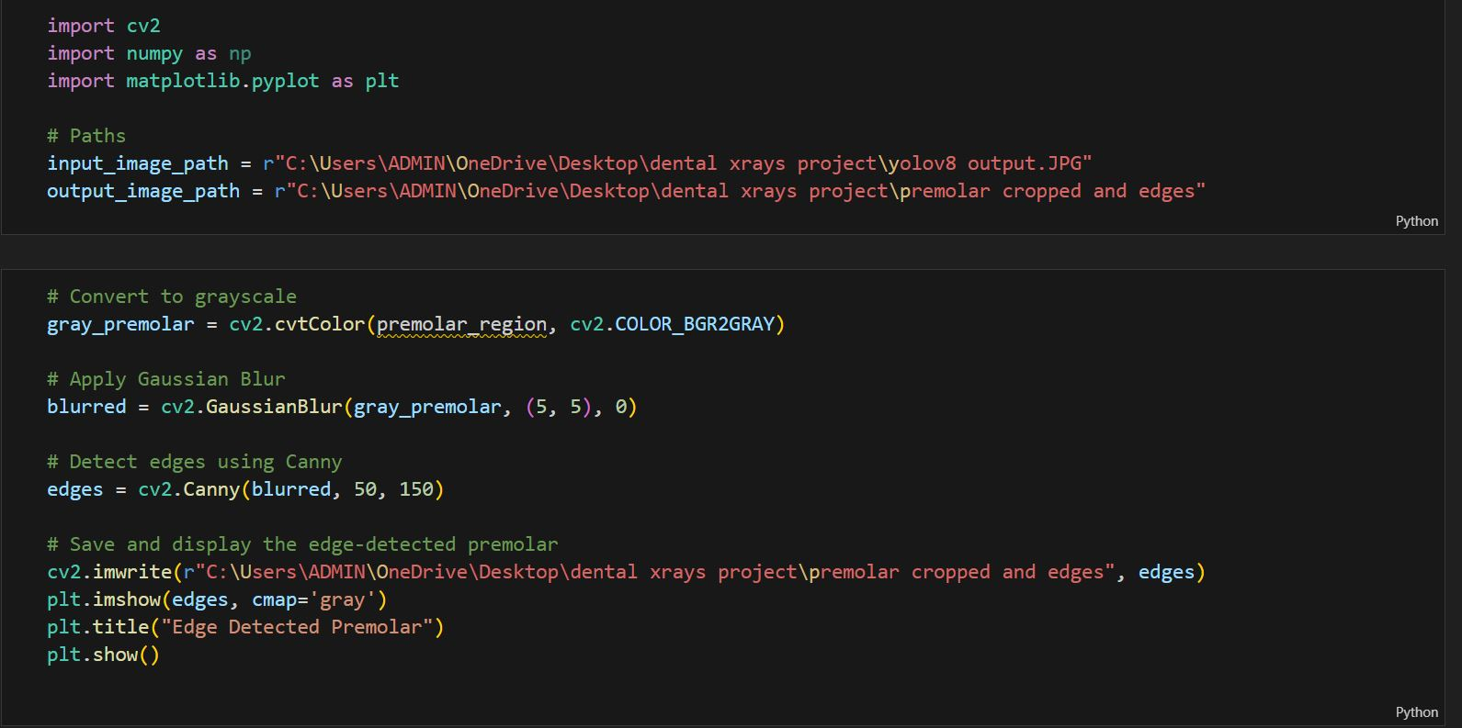

Slide 18
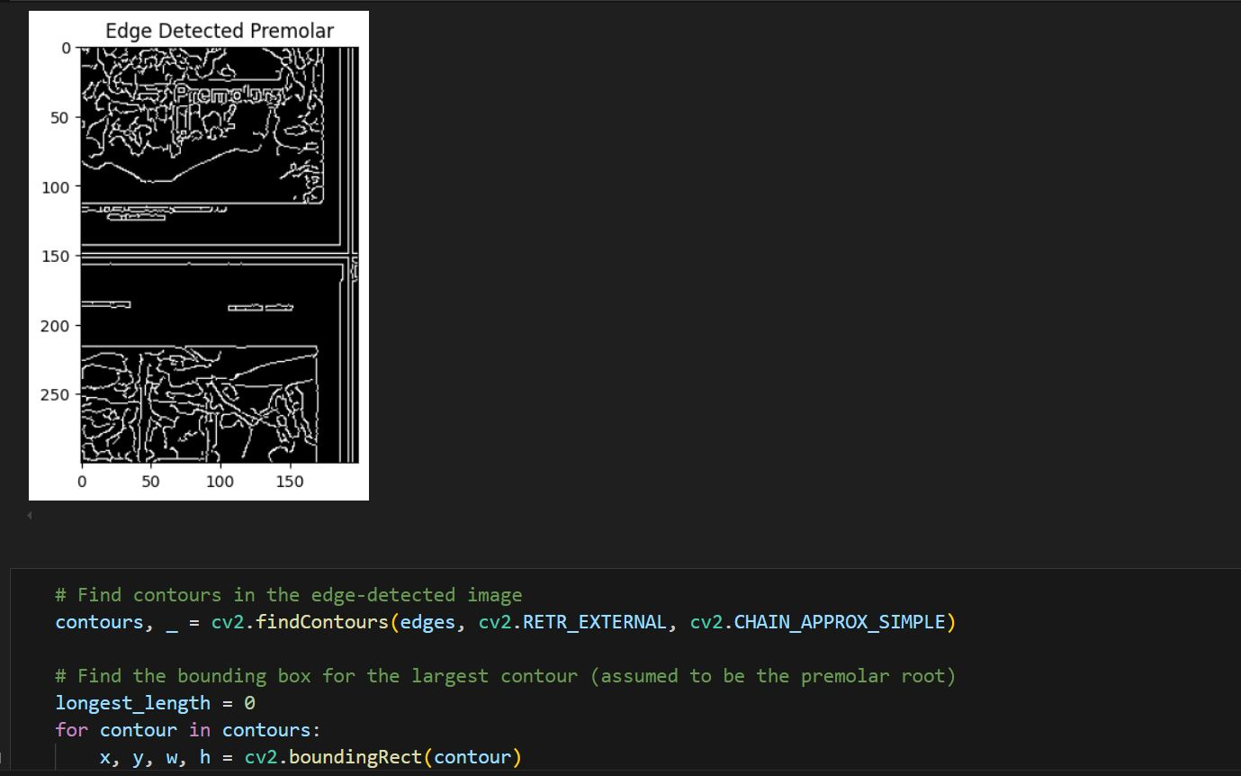
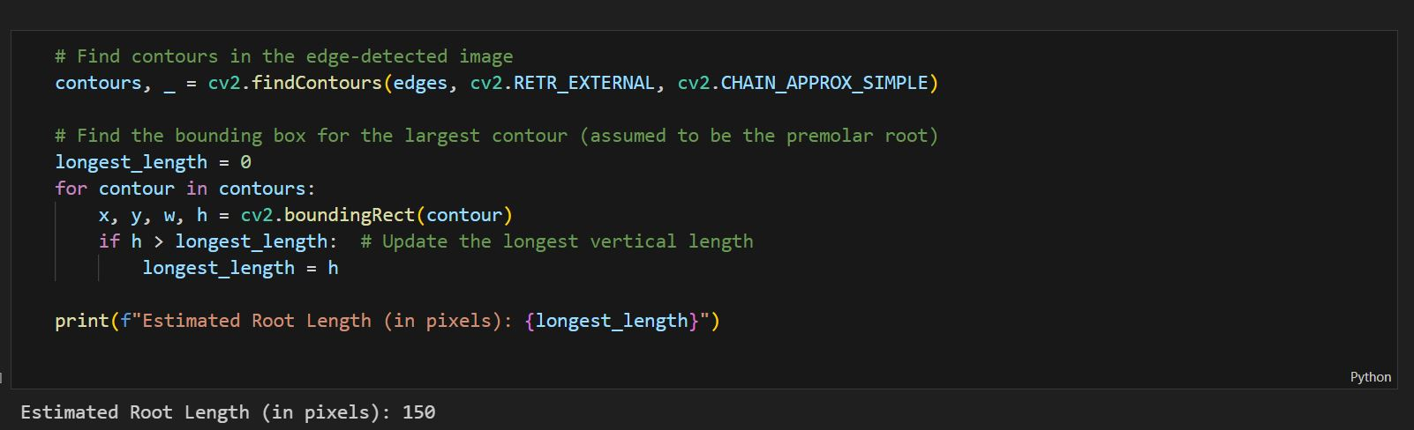

Slide 19
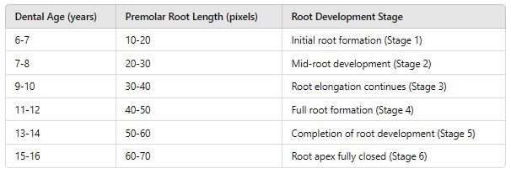
Dental Age and Pre-Molar Root Length Relation Table

Slide 20
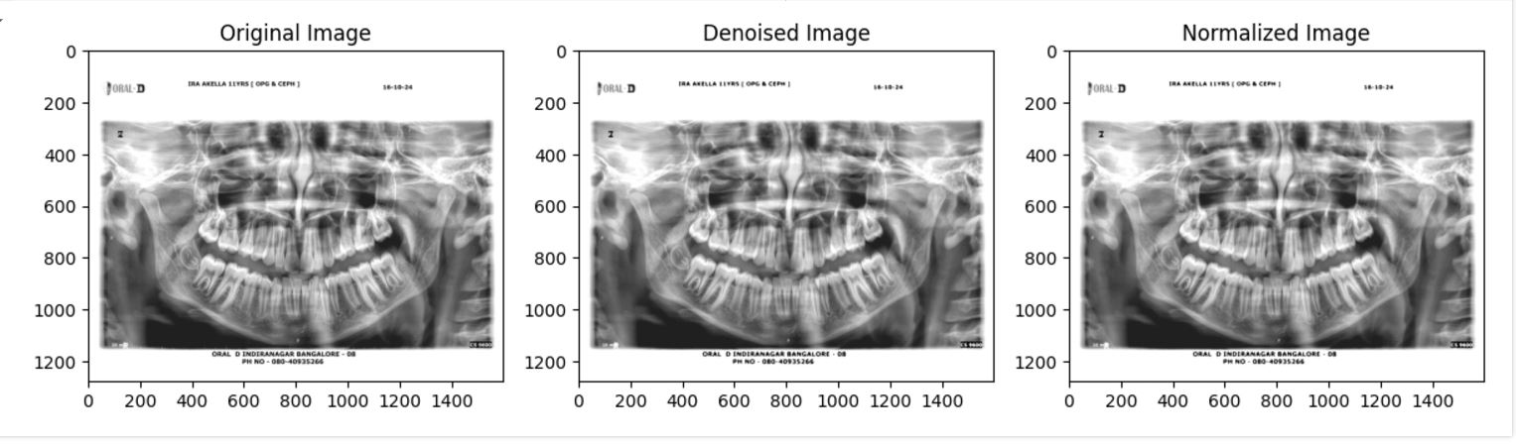
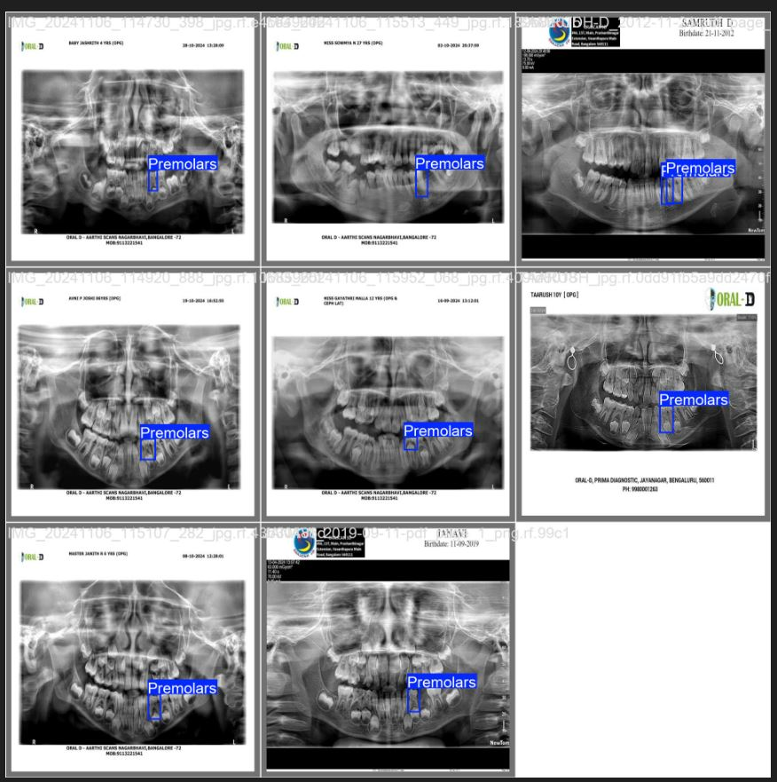
Output 1.Pre-Processing 2.Yolov8 Output

Slide 21
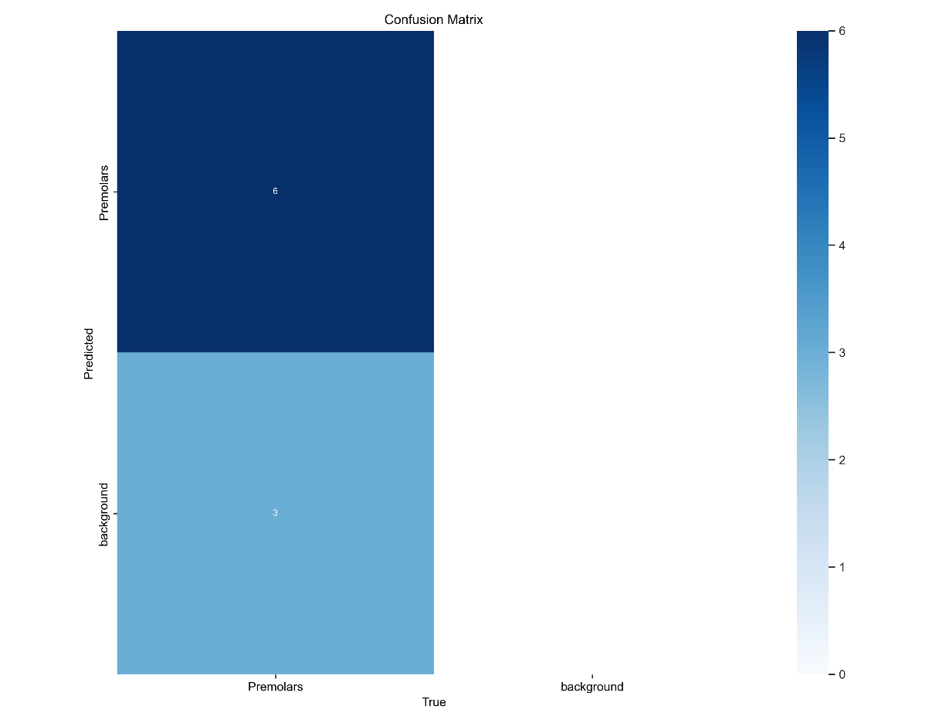
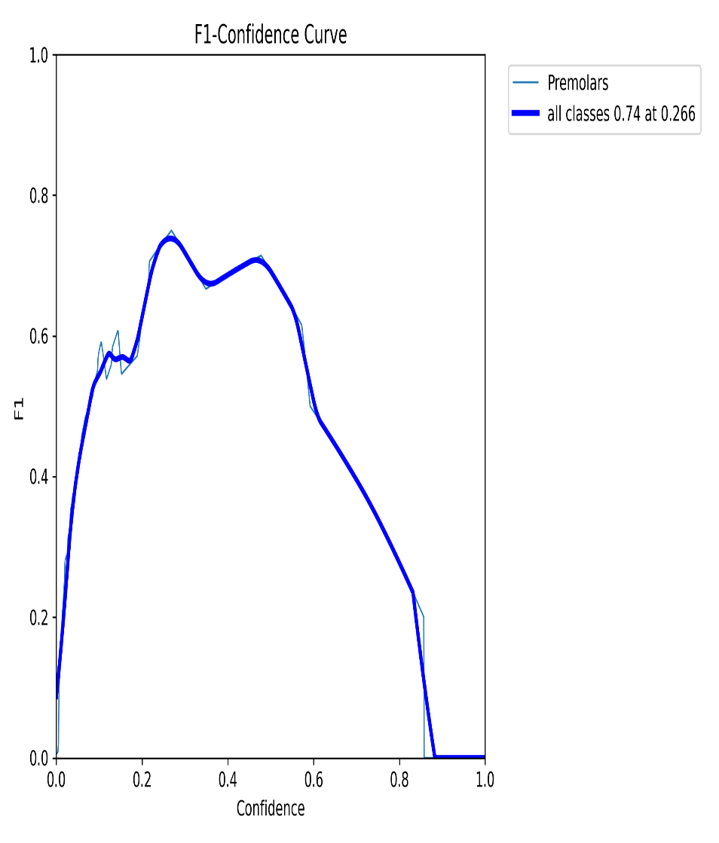
3.Confusion Matrix 4.F1-Curve

Slide 22
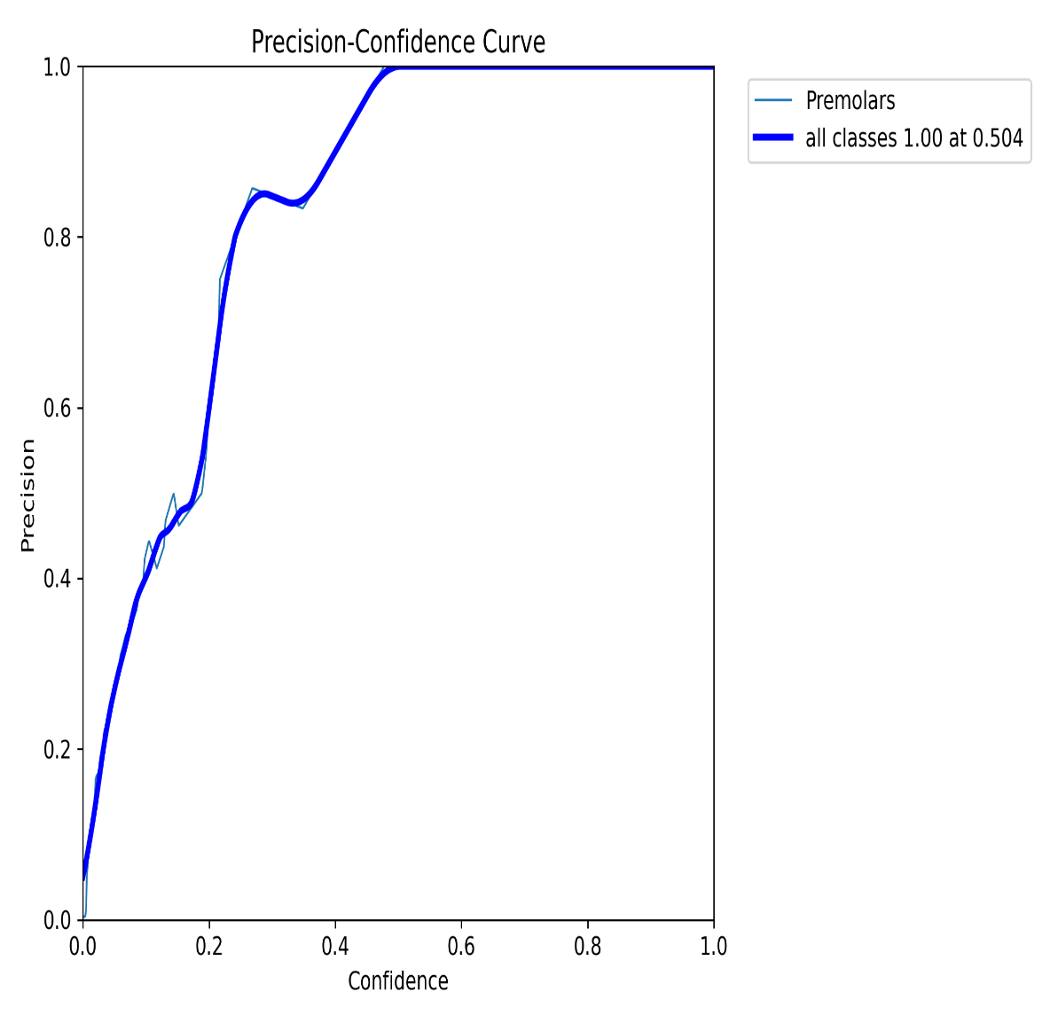
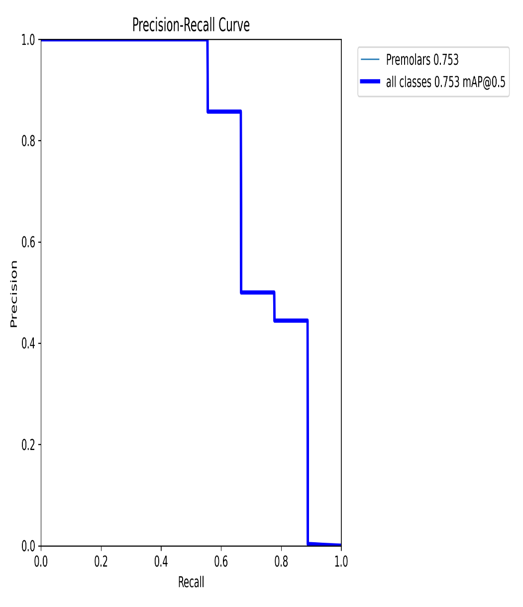
5.P-Curve 6.PR-Curve

Slide 23
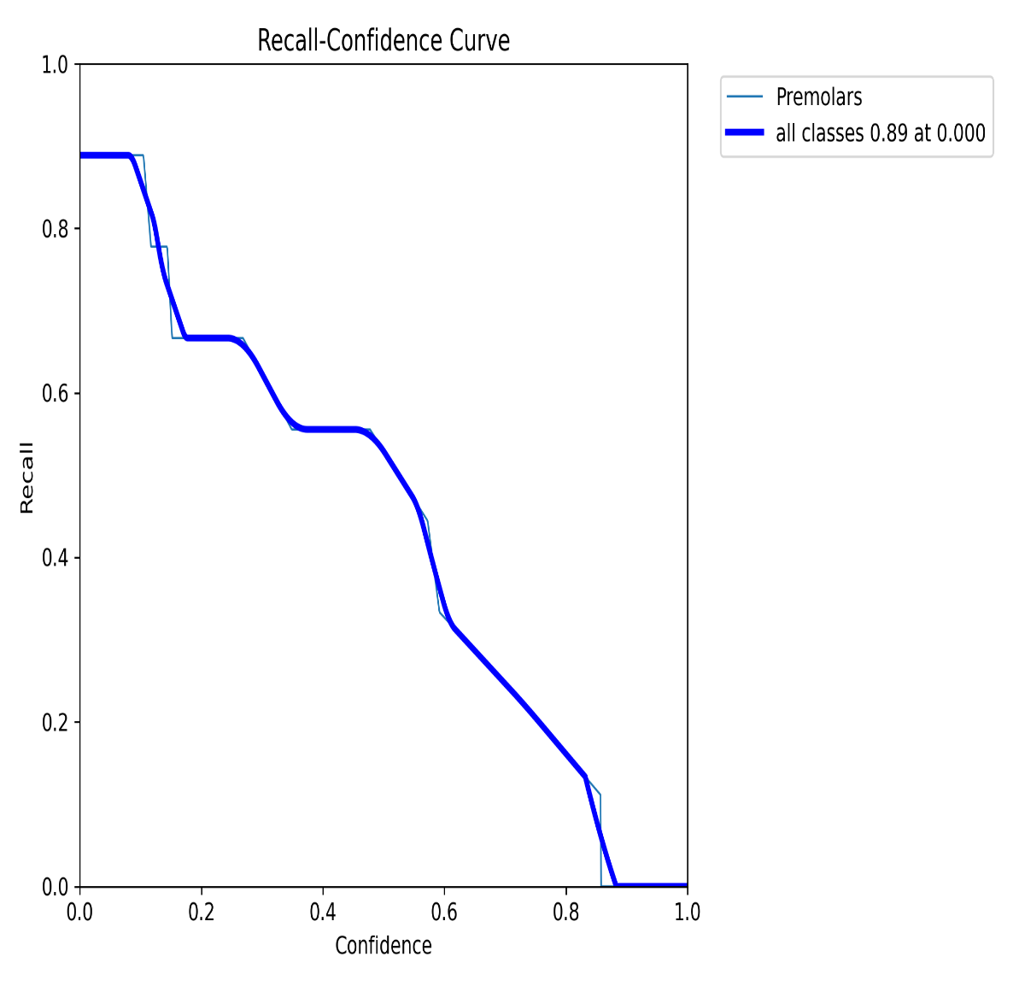
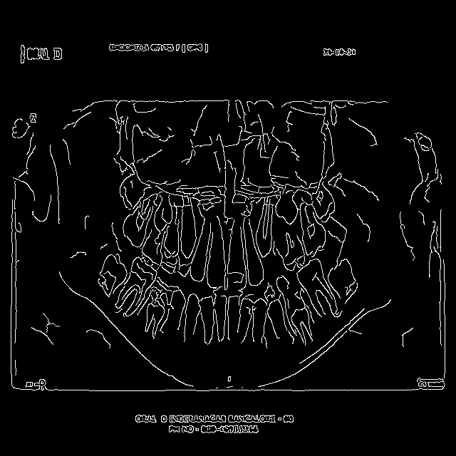
7.RC-Curve 8.Edge prediction

Slide 24
References
[1] Kokomoto, K., Kariya, R., Muranaka, A. et al. Automatic dental age calculation from panoramic radiographs using deep learning: a two-stage approach with object detection and image classification. BMC Oral Health 24, 143 (2024). https://doi.org/10.1186/s12903-024-03928-0
[2] Galibourg, A., Cussat-Blanc, S., Dumoncel, J. et al. Comparison of different machine learning approaches to predict dental age using Demirjian’s staging approach. Int J Legal Med 135, 665–675 (2021)SPRINGER. https://doi.org/10.1007/s00414-020-02489-5
[3] Predictive Artificial Intelligence Model for Detecting Dental Age Using Panoramic Radiograph Images by Sumayh S. Aljameel 1,*ORCID,Lujain Althumairy 1,Basmah Albassam 1,Ghoson Alsheikh 1,Lama Albluwi 1,Reem Althukair 1,Muhanad Alhareky 2,Abdulaziz Alamri 2,Afnan Alabdan 2 andSuliman Y. Shahin 2.https://doi.org/10.3390/bdcc7010008
[4] T. L. Koch, M. Perslev, C. Igel and S. S. Brandt, “Accurate Segmentation of Dental Panoramic Radiographs with U-NETS,” 2019 IEEE 16th International Symposium on Biomedical Imaging (ISBI 2019), Venice, Italy, 2019, pp. 15-19, doi:10.1109/ISBI.2019.8759563.https://ieeexplore.ieee.org/abstract/document/8759563?casa_token=apFu_eRsA1wAAAAA:l3bZeOD1_J3OSJXg56DBE5fItn3vzhj9hE9i6hnI0OOXikzNThd9YePReCyezcfEAGCLl2tICruvlw
[5] Mohamed, E.G.; Redondo,R.P.D.; Koura, A.; EL-Mofty, M.S.;Kayed, M. Dental Age Estimation Using Deep Learning: A Comparative Survey. Computation 2023, 11, 18. https://doi.org/10.3390/computation11020018

